Slide 1
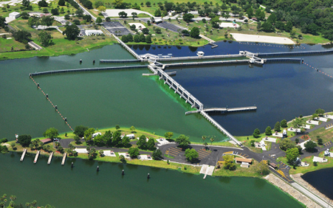
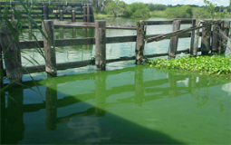
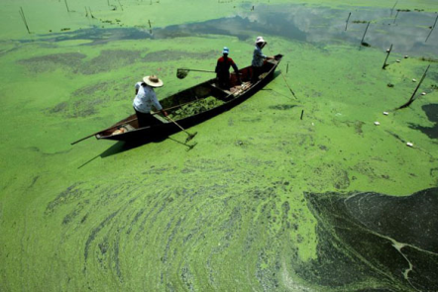
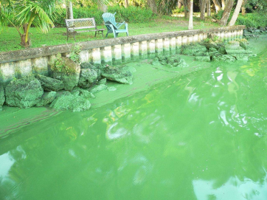

Caloosahatchee & Everglades Restoration
Jennifer Hecker, Director of Natural Resource Policy

Slide 2
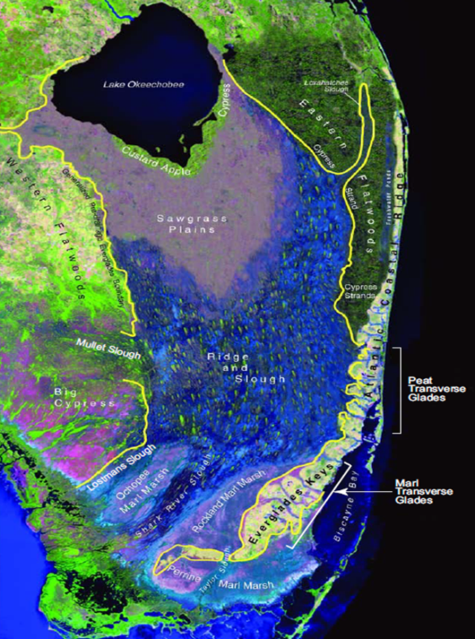
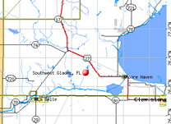
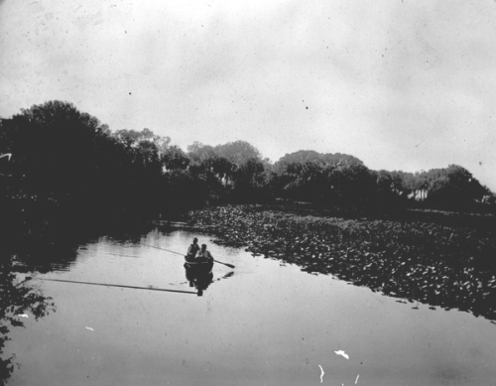
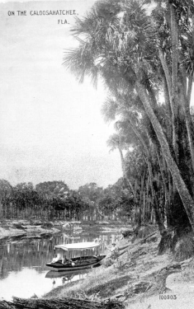
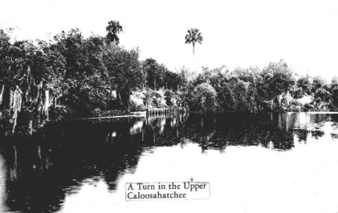
The Historic Caloosahatchee & Everglades
The historic Caloosahatchee was a crooked river with waterfalls that originated from a lake west of Lake Okeechobee.
State Archives of Florida, Florida Memory, http://floridamemory.com

Slide 3
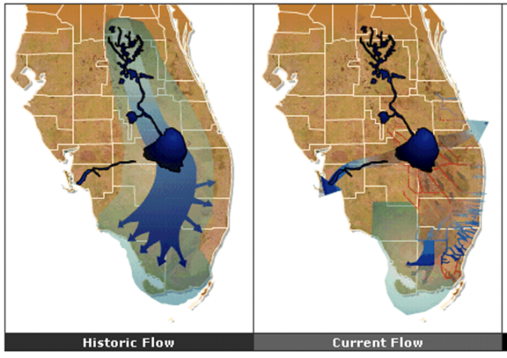
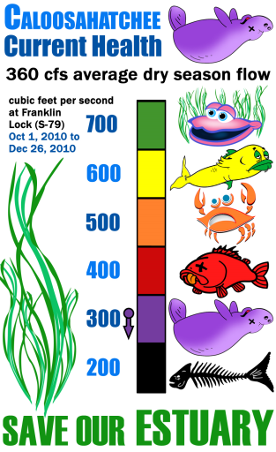
Feast or Famine Flows
Too little flow =
pollution and salinity concentrations to rise to unsafe levels.
stagnating water triggers harmful algae blooms
loss of tapegrass, essential for aquatic life
Too much flow =
additional pollution loading down the river into the estuary and the Gulf
lower salinity levels to a point to fresh for estuarine or marine species.

Slide 4
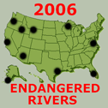
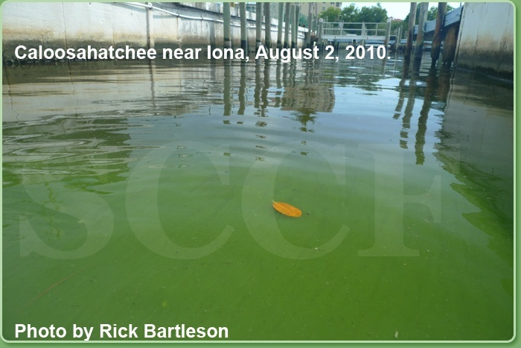
An Endangered River – the Caloosahatchee
Conservancy co-nominated Caloosahatchee, and in 2006 it was selected as one of the 10 most “endangered rivers in the US – a decade ago! – for same problems it is still facing today.

Slide 5
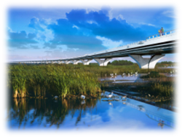
Piecing Together Restoration
Fixing high flows
  more storage in C. basin
  more flow south of Lake O,
  removing impediments
Fixing low flows
  with more storage in C. basin
Fixing water quality
  more treatment above Lake O
  more treatment in C. basin
  More treatment south of the Lake

Slide 6
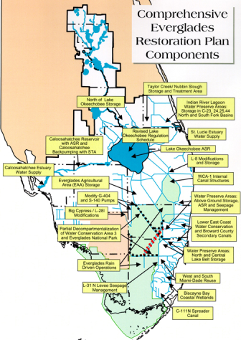
CERP
Includes CEPP, C-43 and other identified projects in the plan (60 total).
Passed in 2000 by Congress, 50/50 cost share with federal and state $
Includes 18,000 square miles of land in 16 counties.
Largest most expensive ecosystem restoration plan in the world with original 1998 cost estimate of $7.8 Billion plus $182M annually ongoing.

Slide 7
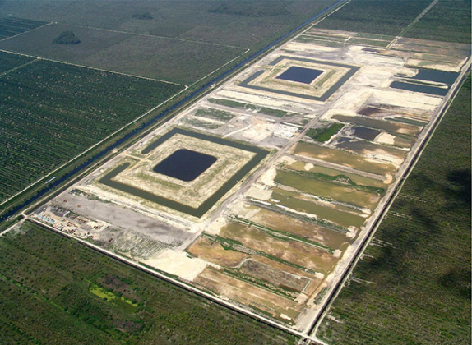
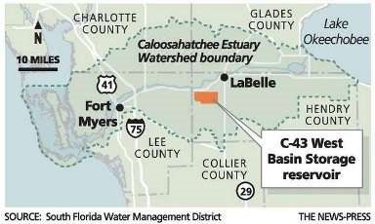
C-43 Reservoir West Basin Storage Project
Land already purchased by the state
Test cells constructed (pic left)
$596M project
State funded $19M and committed to rest
SFWMD recently began construction, with credit from feds for doing so.

Slide 8
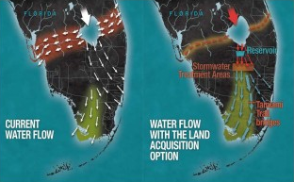
Restoring More Flow South of Lake O
Funding and constructing all the Comprehensive Everglades Restoration Plan (CERP) projects
Acquiring more lands in the Everglades Agricultural Area (EAA) to store and treat more water
Funding the USEPA/DEP Water Quality Plan to build additional water quality treatment

Slide 9
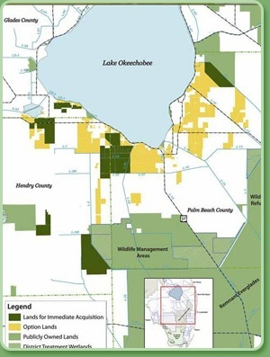
EAA / US Sugar Land Purchase
In 2009, Governor Crist negotiated a deal to buy 72,500 ac of US Sugar’s land in EAA for $533 million with an option to purchase the additional lands within the next 10 years.
The State terminated a purchase option last year to buy additional 46,500 at an estimated $350 M, which would have taken 1 foot off lake - significantly reducing high flows by 40-50%
A non-exclusive option still remains to purchase up to 153,200 acres at Fair Market Value. U.S. Sugar could sell all or a part of the option property, with Right of First Refusal by the SFWMD.
April 2009 SFWMD map showing the U.S. Sugar Corp. parcels that were of original purchase (dark green) and lands in yellow that now have option to purchase.

Slide 10
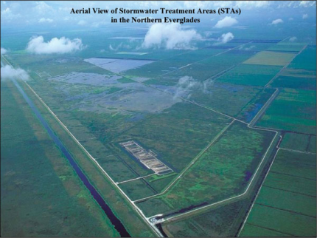
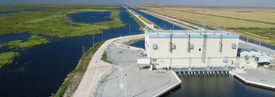
Federal State Water Quality Plan
CERP did not have enough treatment to reach 10ppb TP water quality standard for Everglades
Lawsuit resulted in additional plan and projects to address water quality.
Estimated $1 Billion
Primarily involves building more taxpayer-funded water quality treatment projects

Slide 11
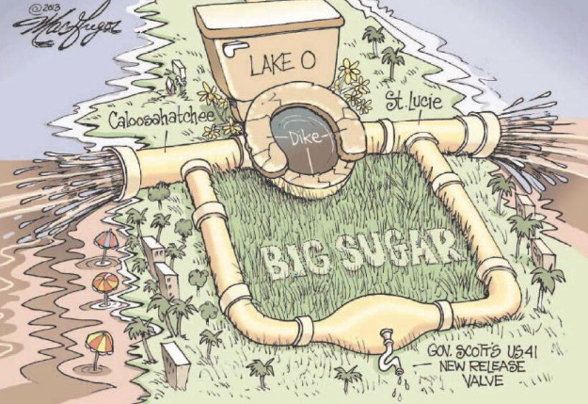
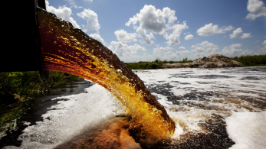
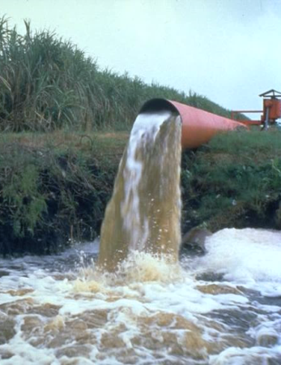
Fixing Water Quality Requires Controlling Pollution at Its Source!

Slide 12
Bringing All Pieces of the Puzzle Together
Includes CEPP, C-43 and other CERP projects
Includes Lake Okeechobee Watershed Plan to store more water north of Lake O
Includes additional lands acquired in EAA to widen conveyance channels to move water south as well as build additional storage and filtration (relieving some of current drainage and pollution as well)
Include better pollution control

Slide 13
