Slide 1
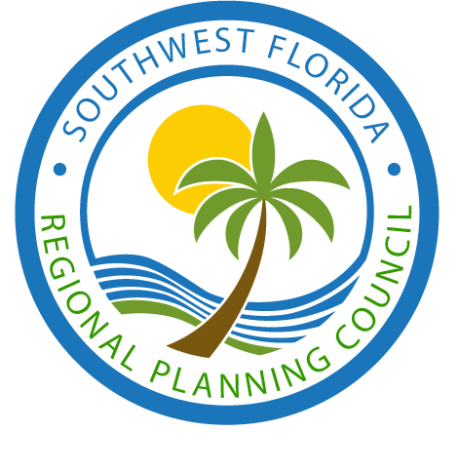
SOUTHWEST FLORIDA REGIONAL PLANNING COUNCIL
Est. 1973

Slide 2
REQUIRED BY STATE STATUTE unfunded
SRPP: Strategic Regional Policy Plan
01
Regional Data Clearing-house / IC&R
02
Annual Report / Financial & Audit Reporting
03
Regional Dispute Resolution
04

Slide 3
ONGOING PROGRAMS FUNDED BY FEDERAL GOVERNMENT
Local Emergency Planning Committee
01
Outreach, Education, & Comprehensive Emergency Management Plan
Hazardous Material Emergency Planning
02
Training of first responders
Economic Development District
03
CEDS required for federal funding
Impact modeling provided

Slide 4
The Regional Planning Councils Are Delegated:
37
11
duties within
chapters:
CHAPTER 129: ADMINISTRATIVE PROCEDURES ACT
CHAPTER 163: INTERGOVERNMENTAL PROGRAMS
CHAPTER 186: STATE & REGIONAL PLANNING
CHAPTER 258: MYAKKA RIVER MANAGEMENT COORDINATING COUNCIL
CHAPTER 260: FLORIDA GREENWAYS & TRAILS COUNCIL
CHAPTER 288: COMMERCIAL DEVELOPMENT & CAPITAL IMPROVEMENTS
CHAPTER 339: TRANSPORTATION FINANCE & PLANNING
CHAPTER 380: LAND AND WATER MANAGEMENT
CHAPTER 403: ENVIRONMENTAL CONTROL
CHAPTER 420: HOUSING
CHAPTER 1013: EDUCATIONAL FACILITIES

Slide 5
CHAPTER 186: STATE & REGIONAL PLANNING
Statute provides protection for regional planning councils created pursuant to Chapter 163, F.S.
Must take into account that the accuracy and reliability of maps and data for GIS may be limited to various factors.
Submit an audit report and an annual financial report for the previous fiscal year.
CHAPTER 260: FLORIDA GREENWAYS & TRAILS COUNCIL
Serve on the Florida Greenways and Trails Council. Membership rotates among the 7 RPCs.
CHAPTER 288: COMMERCIAL DEVELOPMENT & CAPITAL IMPROVEMENTS
An appointed representative by FRCA shall serve on the Rural Economic Development Initiative.
Participate in a pre-submission workshop concerning a military base reuse plan.
CHAPTER 339: TRANSPORTATION FINANCE & PLANNING
Develop transportation goals and policies as part of the SRPP.
CHAPTER 380: LAND AND WATER MANAGEMENT
Serve on Resource Planning and Management Committees as designated by the Governor prior to an area being designated as an Area of Critical State Concern.
Provide technical assistance to local governments in the preparation of land development regulations and local comprehensive plans in Areas of Critical State Concern.
CHAPTER 403: ENVIRONMENTAL CONTROL
Serve on Ecosystem Management Advisory Teams.
Perform local hazardous waste management assessments and provide technical expertise.
Follow the local hazardous waste management assessment guidelines to properly implement the assessments.
Designate sites for regional hazardous waste storage or treatment facility could be constructed.
Participate in regional permit action teams.
CHAPTER 420: HOUSING
One representative from RPCs shall serve on the Affordable Housing Study Commission, as appointed by Governor.
CHAPTER 1013: EDUCATIONAL FACILITIES
Review Campus Master Plans prior to adoption and provide comments.
CHAPTER 258: MYAKKA RIVER MANAGEMENT COORDINATING COUNCIL
Required to serve on Myakka River Management Coordinating Council
CHAPTER 129: ADMINISTRATIVE PROCEDURES ACT
When an administrative law judge presides over a matter involving RPC, RPC shall reimburse administrative law judge’s travel expenses.
CHAPTER 163: INTERGOVERNMENTAL PROGRAMS
Review and comment on regional resources or facilities identified in the SRPP.
Review proposed plans or plan amendments under the State Coordinated Review
CHAPTER 186: STATE & REGIONAL PLANNING
Act as a regional data clearinghouse.
Designated as the primary organization to address problems and plan solutions that are of greater-than-local concern.
Florida's only multipurpose regional entity to plan for and coordinate intergovernmental solutions to growth-related problems; provide technical assistance to local governments; and, meet other needs of the communities in each region.
Provide technical assistance to local governments on growth management matters.
Assist local governments with activities designed to promote and facilitate economic development.
Meet statutory requirements regarding membership for a regional planning council.
Conduct business to run the organization.
Provide advice to constituent local governments on regional, metropolitan, county, and municipal planning matters.
Cooperate with federal and state agencies in planning for emergency management.
Coordinate with other regional entities in preparing and assuring regular review of the Strategic Regional Policy Plan.
Coordinate land development and transportation policies that foster region-wide transportation systems.
Review plans of independent transportation authorities and metropolitan planning organizations to identify inconsistencies between those agencies’ plans and applicable local government plans.
Provide consulting services to a private developer or landowner under certain circumstances.
Prepare and adopt by rule a Strategic Regional Policy Plan (SRPP). SRPP shall be prepared at least every 5 years.
Establish by rule a dispute resolution process to reconcile differences on planning and growth management issues between local governments, regional agencies, and private interests.
Provide annual report of activities.
Conduct scoping meetings upon request, to identify relevant planning issues.

Slide 6
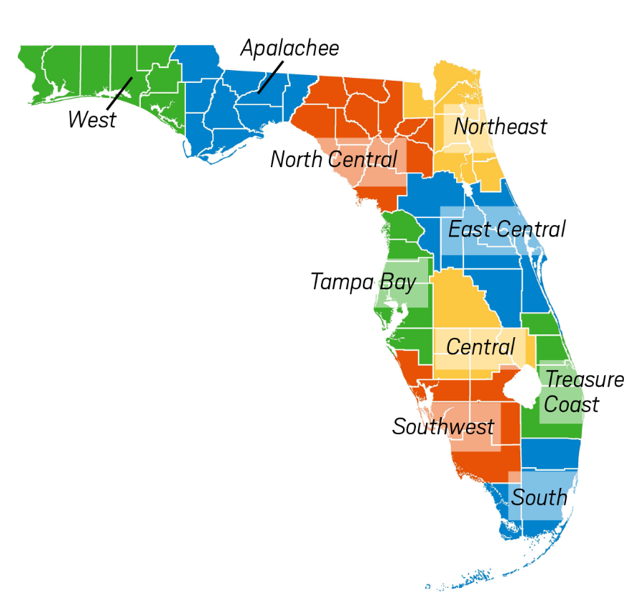
Regional Planning Councils |  | Date Established | 2017 Regional Population | Governing Board Size | Staff Size FTE | Square Miles | Budget in millions
 | Apalachee Calhoun, Franklin, Gadsden, Gulf, Jackson, Jefferson, Leon, Liberty, Wakulla | Aug. 1977 | 485,278 | 27 | 8 | 6,757 | $ 0.9
 | Central Florida DeSoto, Hardee, Highlands, Okeechobee, Polk | Jul. 1974 | 867,970 | 18 | 18 | 5,287 | $ 3.5
 | East Central Florida Brevard, Lake, Marion, Orange, Osceola, Seminole, Sumter, Volusia | Feb. 1962 | 4,006,558 | 35 | 12 | 9,244 | $ 1.6
 | North Central Florida Alachua, Bradford, Columbia, Dixie, Gilchrist, Hamilton, Lafayette, Levy, Madison, Suwannee, Taylor, Union | May. 1969 | 557,004 | 44 | 11 | 8,660 | $ 2.1
 | Northeast Florida Baker, Clay, Duval, Flagler, Nassau, Putnam, St. Johns | Apr. 1977 | 1,661,055 | 35 | 12 | 5,097 | $ 2.4
 | South Florida Broward, Dade, Monroe | Jul. 1974 | 4,693,954 | 19 | 17 | 7,492 | $ 2.3
 | Southwest Florida Charlotte, Collier, Glades, Hendry, Lee, Sarasota | Nov. 1973 | 1,688,062 | 30 | 4 | 7,278 | $ 1.6
 | Tampa Bay Citrus, Hernando, Hillsborough, Manatee, Pasco, Pinellas | Feb. 1962 | 3,541,479 | 44 | 8.5 | 4,998 | $ 2.3
 | Treasure Coast Indian River, Martin, Palm Beach, St. Lucie | Aug. 1976 | 2,013,762 | 28 | 9 | 4,441 | $ 2.4
 | West Florida Bay, Escambia, Holmes, Okaloosa, Santa Rosa, Walton, Washington | Oct. 1964 | 969,020 | 33 | 35 | 6,509 | $ 3.5
5th Largest Population
4th Largest in Square Miles
Least # of Employees
Notes:
Updated staff and council size to current numbers. Updated budget to reflect no fund balance.

Slide 7
Primary Focus Areas for all 10 regional planning councils:
Regional Conveners
Transportation
Quality of Life
Emergency Preparedness
Economic Development

Slide 8
RELEVANCY:
This Is What We Heard from County Managers…
Water Quality regional mitigation, resolutions, and eco-systems calculations of negative impacts of red tide and algae blooms.
Affordable Housing regional and state coordination of planning for communities, policies, and programs.
Regional Transportation proactively planning for alternative and multi-modal transportation.
Storm Resiliency & Climate Change capacity-building for economic, social, community health, infrastructure and environmental issues.
Quality of Life regional opioid prevention, public safety, mental health, and healthy futures.
Inter-governmental Coordination & Communication
region-wide facilitation, research, and developing partnerships in many areas that make a difference locally and state-wide

Slide 9
Relevancy issues from the RPC board…..
May 16, 2019
Water Quality
Affordable Housing
Regional Coalition Common Voice in Tallahassee
Beach Renourishment
Quality of Life
Information on Common Issues
Collective Force to combat erosion of Homerule
The “Go-To” People for Organizing Among Counties
Impact of Development on Adjacent Counties
Coordinate and Share Information with County Staff

Slide 10
This is what we heard - meeting changes
Quarterly meetings
Half Day Event Meeting (Mini Conference)
Short Business Meeting followed by a meaningful Presentation on an Important Issue

Slide 11
Required by State Statutes - Unfunded
Update & Maintain
The Strategic Regional Policy Plan
Be The Regional Data Clearinghouse / IC&R (Intergovernmental Coordination And Review)
Provide Annual Report/
Financial Audit & Reporting
Regional Dispute
Resolution if Requested

Slide 12
Ongoing Programs Funded by the Federal Government ($172,164)
Local Emergency Planning Committee
Hazardous Material Emergency Planning
Economic Development District

Slide 13
Provide Information on Common Issues impacting the region
Impact Of Development On Adjacent Counties
Coordinate & Share Information With County Staff
Provide Information On Common Issues
Home Rule
Water Quality
Affordable Housing
Beach Renourishment
Resiliency
Quality of Life Issues
Impact of Development
Coordinate and Share Information
Information on Common Issues
Collective Force

Slide 14
Inter-governmental Coordination & Communication
Hold one public workshop meeting with Board members to identify the issues to be included in our Common Voice and set the Agenda for quarterly meetings and major event
Coordinate quarterly RPC meetings with presentations on relevant common issues
Coordinate and host one major event with a prominent speaker on an issue of importance to the RPC Board members
Share all comp plan amendments with adjacent counties and County/City Planning Staff
Coordinate meeting with all planning directors and appropriate planning staff twice a year

Slide 15
Moving
Forward

Slide 16
What is the new Direction?
1.
2.
3.
4
5.
6.

