Slide 1
When Fracking Isn't Called Fracking: Flawed Well Stimulation Definition in Proposed State Oil Legislation (HB 191/SB 318) Excludes Most Common Form of Fracking-like Extraction in FL
(image and article at https://www.onepetro.org/journal-paper/SPE-129329-JPT)
Industry depiction of acid stimulation / matrix acidizing wormholes formed
in carbonate rock dissolved with acids and fracking chemicals

Slide 2
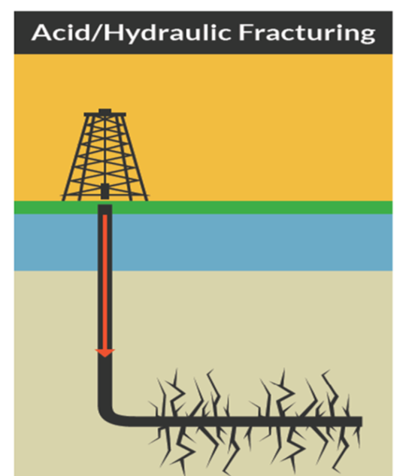
aka Matrix Acidization
High pressure well stimulation that created fractures
Considered “Fracking” by industry
Does not create fractures (dissolves the rock)
Not “Fracking” to industry
Yet both use a lot of freshwater, inject hazardous “fracking” chemicals underground and create toxic flowback to be disposed of
Notes:
There are two categories of oil well stimulation—those techniques that fracture rock and those that dissolve rock.

Slide 3
“In matrix acidizing, the goal is to dissolve minerals in the rock to increase well productivity. This is accomplished by injecting an application-specific solution of acid into the formation at a pressure between the pore pressure and fracture gradient,” (emphasis added to highlight below fracture gradient)
Note: Florida’s geology is carbonate rock

Slide 4
Real life at the Hogan well: Question at onset as to whether “fracking” or “acid stimulation” occurred
Commissioned by DEP
Notes:
Following the hydraulic fracturing operation, there was a great deal of confusion in defining the procedure. It wasn’t until 1 year later that DEP consultants concluded it was hydraulic fracturing.

Slide 5
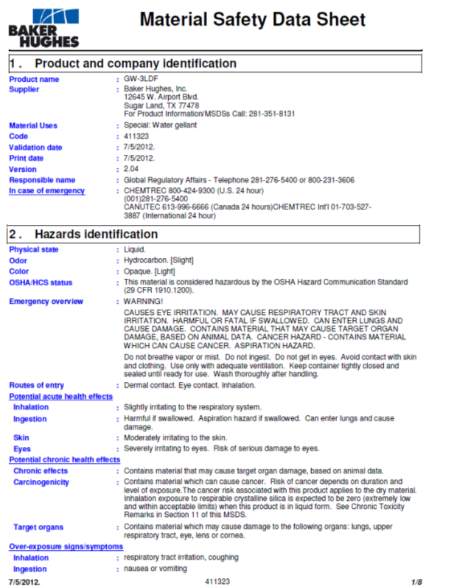
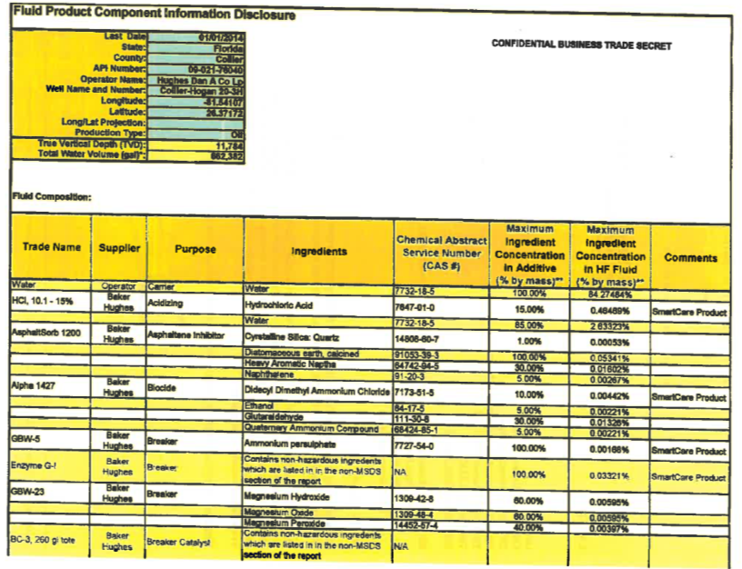
Eventual confirmation of fracking at the Hogan well
Trade secret documents were evaluated by independent expert, who concluded in Dec. 2014 that well had been hydraulically fracked - after well was also acid stimulated to dissolve rock.
MSDS from Hughes HF proposal
Chemical disclosure list page 1 of 3—claimed trade secret
Notes:
Overview of hydraulic fracturing operation at the Hogan well. This well was permitted to use 280.32 million gallons of water per year from the lower tamiami aquifer. Over just 3 days the operators used over 662,000 gallons in a hydraulic fracturing operation. Here is the first page of the chemical disclosure list. The entire document was initially classified as trade secret.

Slide 6
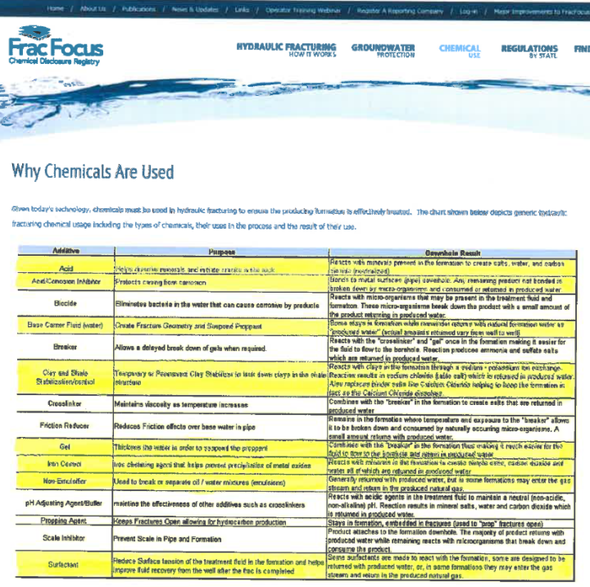
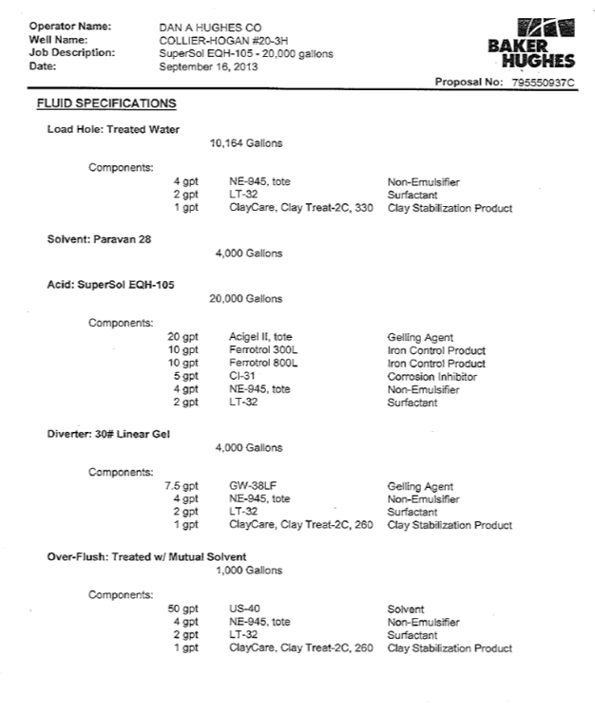
But acid stimulation with fracking chemicals also confirmed at the Hogan well
Common fracking chemicals on FracFocus site highlighted to show those used when well acidized
Excerpt from Hughes acidizing proposal
Notes:
An acid stimulation operation was the first stimulation done at the Hogan well. This procedure involved the injection of 20,000 gallons of acid and other chemicals into the well under low pressure. The operation used several of the same chemical additives found in fracking fluid—these are highlighted in the table to the left.

Slide 7
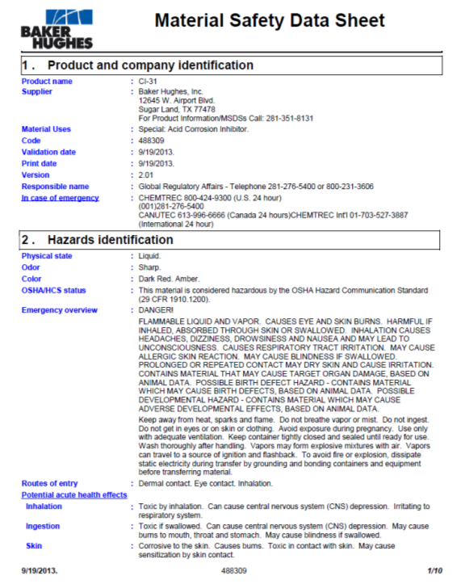
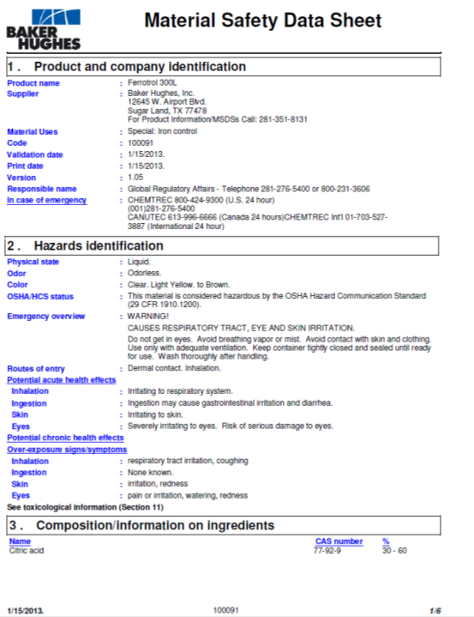
Highly hazardous fracking chemicals used in both the acidizing and fracturing operations
MSDS from Hughes acidizing AND hydraulic fracturing proposal
Notes:
Based on the MSDS we were able to obtain for the acid stimulation operation, it is clear several of the chemicals used in the acidizing operation AND the hydraulic fracturing operation were hazardous to human health.

Slide 8
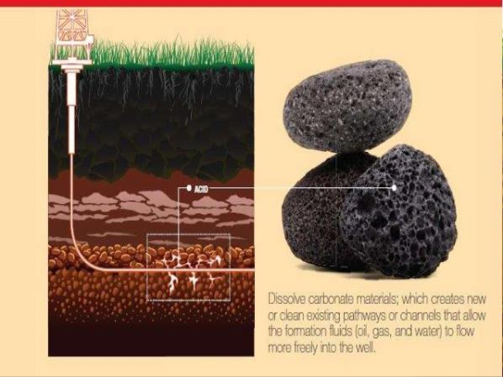
Acid stimulation at the Hogan well – NOT acid cleaning or acid fracking
http://www.slideshare.net/MHaNiFChAChAR/carbonate-acidizing-design-142
Acids did not stay inside or in the immediate vicinity of well as would be the case with acid cleaning
The acid was mixed with standard fracking chemicals
The acid fracking chemical mixture dissolved more than three feet out into solid rock
It did not use pressure exceeding fracture gradient to create fractures
= ACID STIMULATION or “MATRIX ACIDIZING” was used to enhance oil production at Hogan well

Slide 9
California Public Resources Code correctly captures acid stimulation
3157. (a) For purposes of this article, "well stimulation treatment" means any treatment of a well designed to enhance oil and gas production or recovery by increasing the permeability of the formation. Well stimulation treatments include, but are not limited to, hydraulic fracturing treatments and acid well stimulation treatments.
(b) Well stimulation treatments do not include steam flooding, water flooding, or cyclic steaming and do not include routine well cleanout work, routine well maintenance, routine removal of formation damage due to drilling, bottom hole pressure surveys, or routine activities that do not affect the integrity of the well or the formation.
3158. "Acid well stimulation treatment" means a well stimulation treatment that uses, in whole or in part, the application of one or more acids to the well or underground geologic formation. The acid well stimulation treatment may be at any applied pressure and may be used in combination with hydraulic fracturing treatments or other well stimulation treatments. Acid well stimulation treatments include acid matrix stimulation treatments and acid fracturing treatments. Acid matrix stimulation treatments are acid treatments conducted at pressures lower than the applied pressure necessary to fracture the underground geologic formation.
Notes:
Key language from CA Public Resources Code

Slide 10
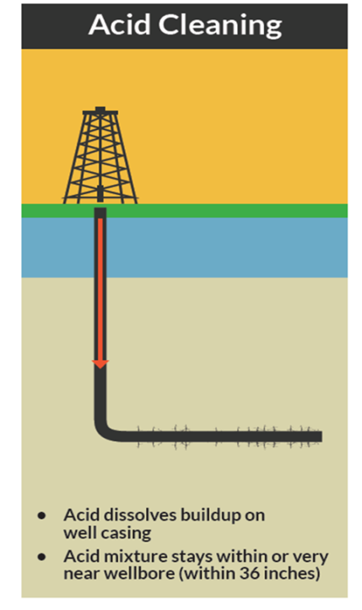
California Code of Regulations (14 CCR § 1761) distinguishes cleaning from stimulation
(B) Well stimulation treatment does not include routine well cleanout work; routine well maintenance; routine treatment for the purpose of removal of formation damage due to drilling; bottom hole pressure surveys; routine activities that do not affect the integrity of the well or the formation; the removal of scale or precipitate from the perforations, casing, or tubing; a gravel pack treatment that does not exceed the formation fracture gradient; or a treatment that involves emplacing acid in a well and that uses a volume of fluid that is less than the Acid Volume Threshold for the operation and is below the formation fracture gradient.
Notes:
Key language from CA Code of Regulations
State of California defines the acid volume threshold as the volume of fluid needed to extend 36 inches or more past the wellbore. Operations that extend 36 inches or more into the formation are well stimulation—those that stay within 36 inches or less of the wellbore are cleaning.

Slide 11
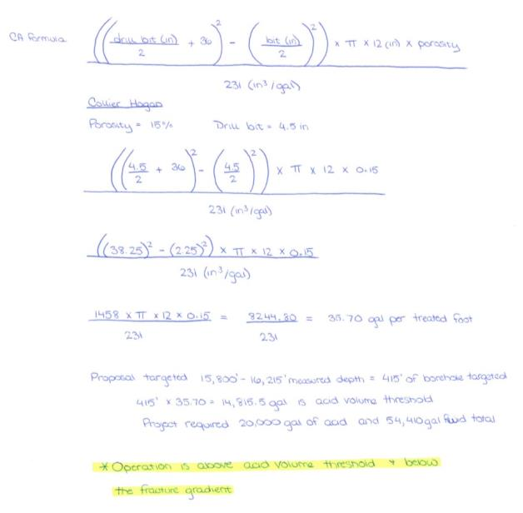
CA formula to distinguish cleaning from stimulation:
(3) “Acid Volume Threshold” means a volume, in US gallons, per treated foot of well stimulation treatment, calculated as follows:
(((Size of the drill bit diameter in inches that was used in the treated zone / 2 + 36 inches)² - (bit diameter in inches / 2)²) x 3.14159 x 12 inches x treated formation porosity) / 231 (inches³/gallon).
The lowest calculated or measured porosity in the zone of treated formation shall be the treated formation porosity used for calculating the Acid Volume Threshold.
Inputting Hogan information into CA formula confirmed it was acid stimulation, not acid cleaning (see above).

Slide 12
HB 191/SB 318 only address techniques that fracture, excluding acid stimulation (as acid stimulation/matrix acidizing dissolves, does not fracture or exceed the fracture gradient)
Excerpt from SB 318
Notes:
Acid stimulation will be excluded from SB 318/HB 191 because it does not generate fractures.

Slide 13
Excluding acid stimulation in HB 191/SB 318 means:
No study
No moratorium
No added regulation
No added disclosure of chemicals
of the technique more commonly being used in our geology – acid stimulation!
SB 318 requires a permit for high pressure fracturing operations only
SB 318 establishes a moratorium for high pressure fracturing operations only
SB 318 studies high pressure fracturing operations only
Not one mention of acid stimulation anywhere in the bills and each place specifically limits only to fracturing
Notes:
The bill only includes “high-pressure” well stimulation—defined as an operation which generates fractures. The bill excludes acidizing and so there is no permit, moratorium, or study for acid stimulation.

Slide 14
HB 191/SB 318 even excludes some fracturing
Excerpt from SB 318
Creates another large loophole as unlikely to fracture given pressure involved to do so, and unclear how to determine which operations “incidentally fracture” – especially beforehand!
Notes:
HB 191/SB 318 is thought to put in place a regulatory framework for hydraulic fracturing where currently none exists in Florida. However, this bill includes language which would exclude operations that “incidentally fracture the formation.” Given the large volumes of water and high pressure used in fracking, it is unclear how such an operation would be done incidentally or how this would be known by DEP.

Slide 15
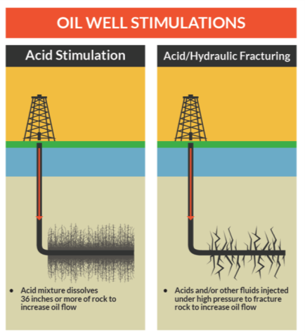
HB 191/SB 318 should at least capture all well stimulation
To even move in right direction with forming the proper foundation for future legislation, legislation must capture ALL forms of well stimulation involving the injection of hazardous chemicals.
Current bill
HB 191/SB 318 fails to address acid stimulation
Legislation must address all well stimulation

Slide 16
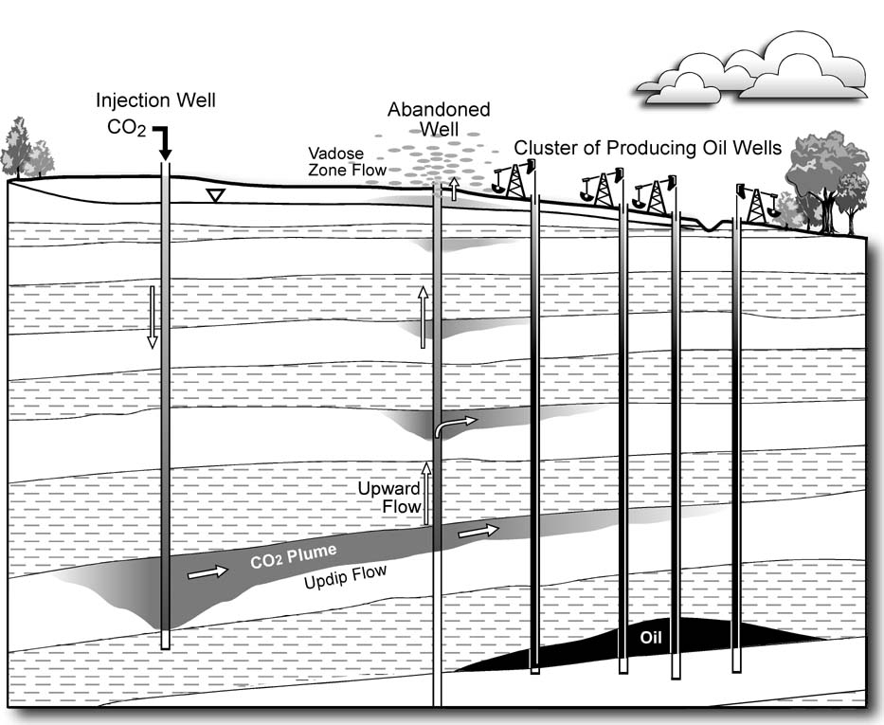
But still will not provide all the public safeguards needed
No requirement that nearby abandoned wells be plugged properly to current standards
No requirement that they use alternative water instead of prime potable water supplies
No requirement that all chemicals be disclosed to local governments so they can provide adequate emergency response
Etc. etc. etc.
https://mrbarlow.files.wordpress.com/2011/12/oil-wells.jpg

